Slide 1



Supply Chain Analytics Dashboard
View in Power BI
Last data refresh:
03/11/2022 11:36:39 UTC
Downloaded at:
04/11/2022 09:49:32 UTC

Slide 2
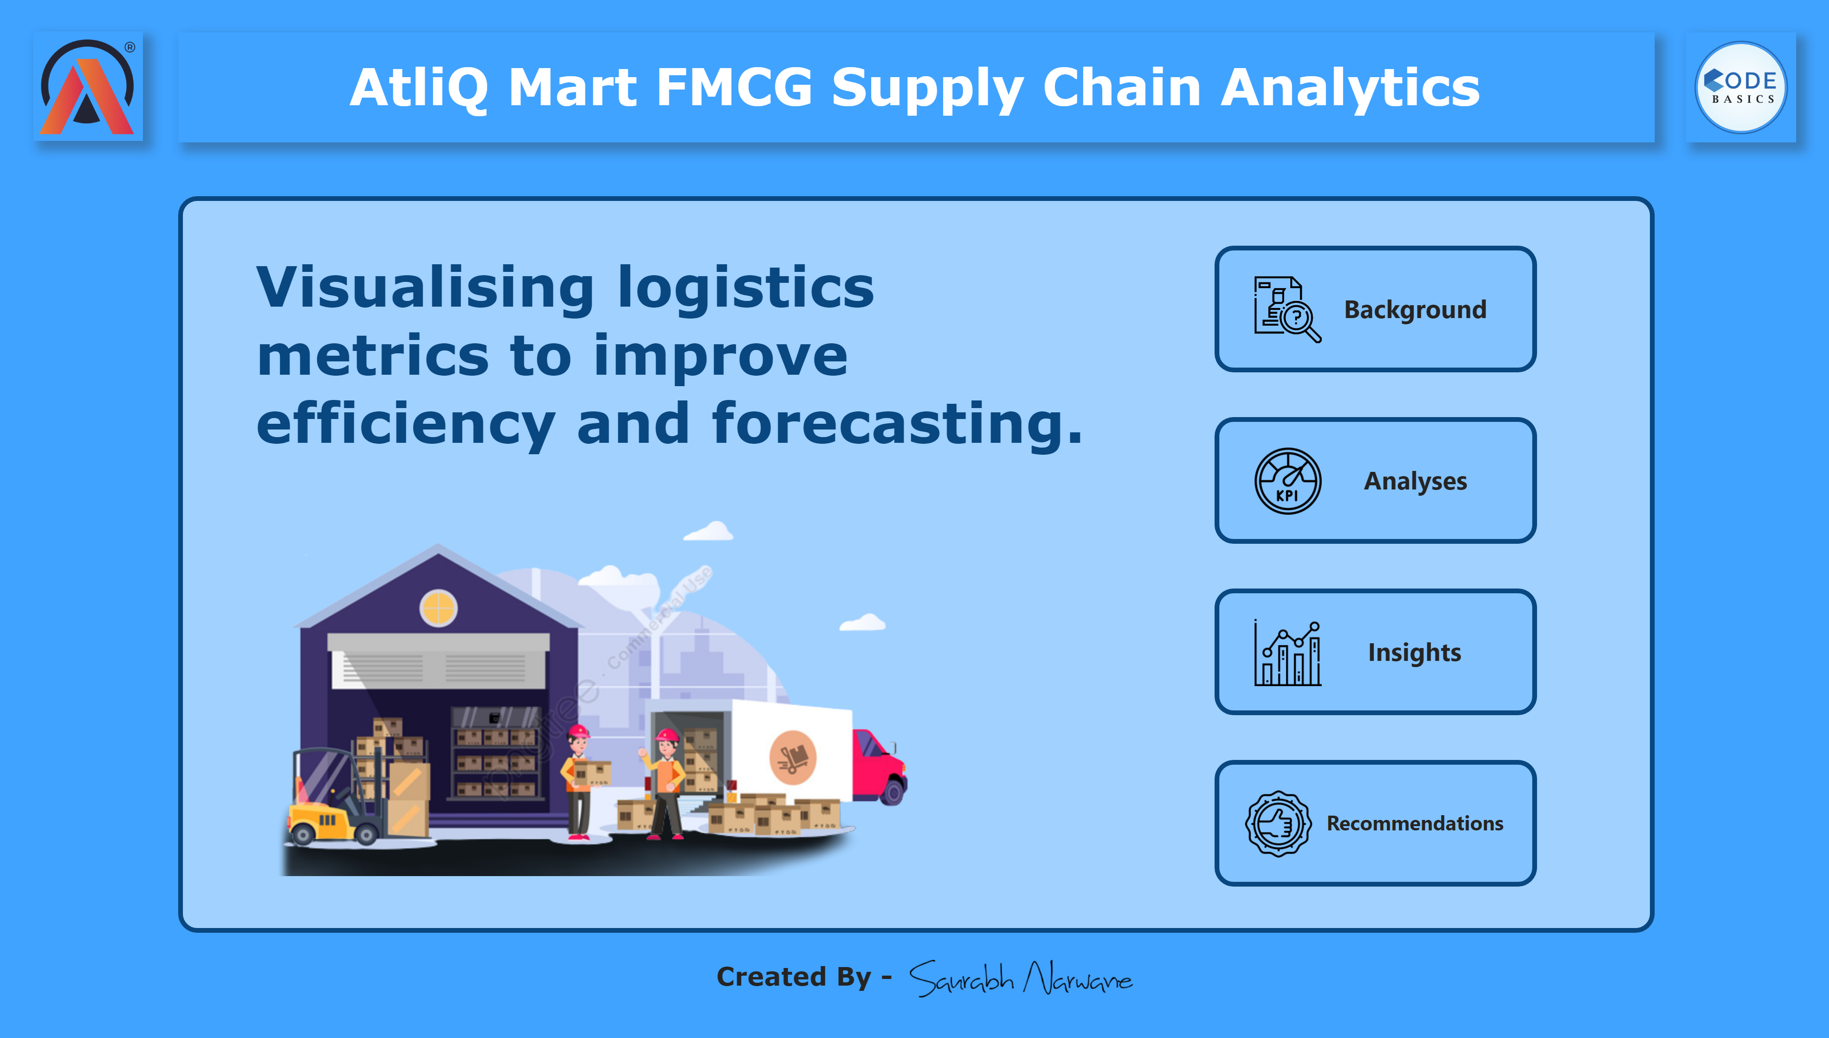
Home Page
Notes:
textbox
No alt text provided
shape
No alt text provided
image
No alt text provided
image
No alt text provided
textbox
No alt text provided
image
No alt text provided
textbox
No alt text provided
textbox
No alt text provided
image
No alt text provided
shape
No alt text provided
shape
No alt text provided
shape
No alt text provided
shape
No alt text provided
shape
No alt text provided
image
No alt text provided
image
No alt text provided
image
No alt text provided
textbox
No alt text provided
textbox
No alt text provided
textbox
No alt text provided
image
No alt text provided

Slide 3
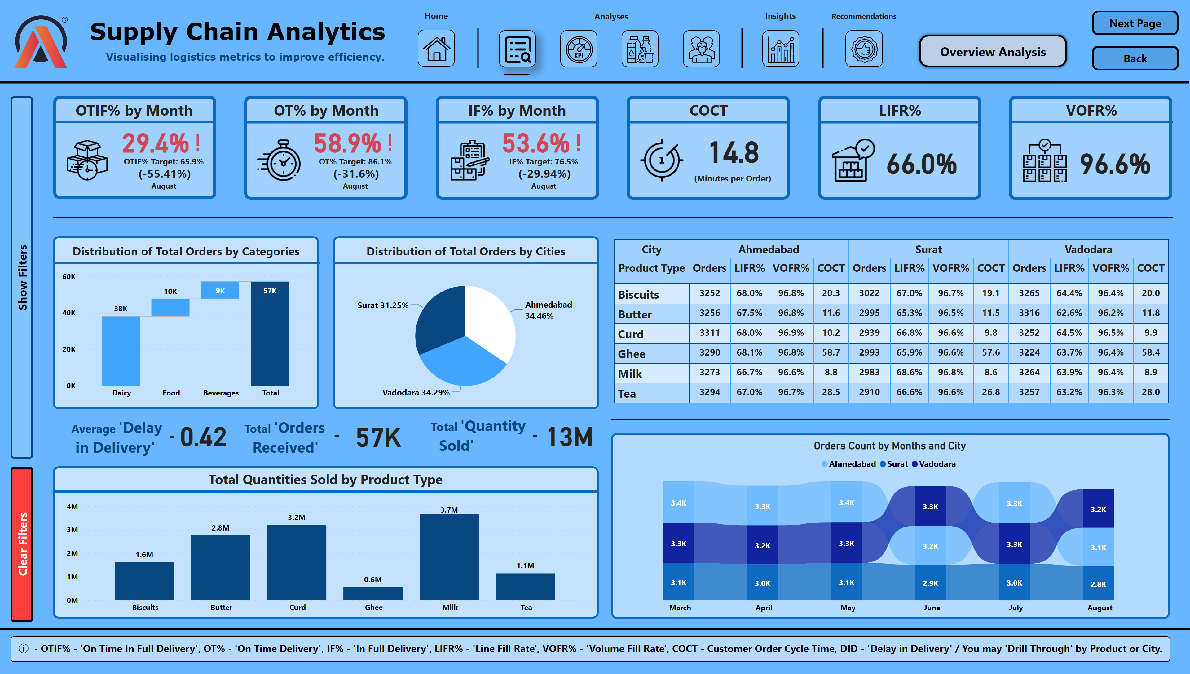
Overview Analysis
Notes:
OT% by Year
No alt text provided
shape
No alt text provided
image
No alt text provided
slicer
No alt text provided
slicer
No alt text provided
slicer
No alt text provided
slicer
No alt text provided
slicer
No alt text provided
slicer
No alt text provided
actionButton
No alt text provided
shape
No alt text provided
textbox
No alt text provided
textbox
No alt text provided
IF% by Year
No alt text provided
image
No alt text provided
image
No alt text provided
image
No alt text provided
card
No alt text provided
card
No alt text provided
image
No alt text provided
image
No alt text provided
textbox
No alt text provided
textbox
No alt text provided
textbox
No alt text provided
textbox
No alt text provided
textbox
No alt text provided
shape
No alt text provided
actionButton
No alt text provided
actionButton
No alt text provided
shape
No alt text provided
shape
No alt text provided
shape
No alt text provided
OTIF% by Year
No alt text provided
shape
No alt text provided
shape
No alt text provided
shape
No alt text provided
shape
No alt text provided
shape
No alt text provided
textbox
No alt text provided
shape
No alt text provided
shape
No alt text provided
shape
No alt text provided
shape
No alt text provided
shape
No alt text provided
shape
No alt text provided
card
No alt text provided
textbox
No alt text provided
image
No alt text provided
Percentage of Orders by Category
No alt text provided
pieChart
No alt text provided
textbox
No alt text provided
card
No alt text provided
textbox
No alt text provided
textbox
No alt text provided
textbox
No alt text provided
textbox
No alt text provided
textbox
No alt text provided
card
No alt text provided
card
No alt text provided
shape
No alt text provided
shape
No alt text provided
shape
No alt text provided
shape
No alt text provided
shape
No alt text provided
textbox
No alt text provided
textbox
No alt text provided
textbox
No alt text provided
image
No alt text provided
image
No alt text provided
image
No alt text provided
image
No alt text provided
image
No alt text provided
actionButton
No alt text provided
actionButton
No alt text provided
columnChart
No alt text provided
shape
No alt text provided
textbox
No alt text provided
shape
No alt text provided
ribbonChart
No alt text provided
shape
No alt text provided
Product wise number of orders LIFR%, VOFR%, LIFR% by Months, and FR% by Months
No alt text provided
shape
No alt text provided
image
No alt text provided
image
No alt text provided
textbox
No alt text provided
textbox
No alt text provided
textbox
No alt text provided
textbox
No alt text provided
shape
No alt text provided
shape
No alt text provided
shape
No alt text provided
shape
No alt text provided
shape
No alt text provided

Slide 4
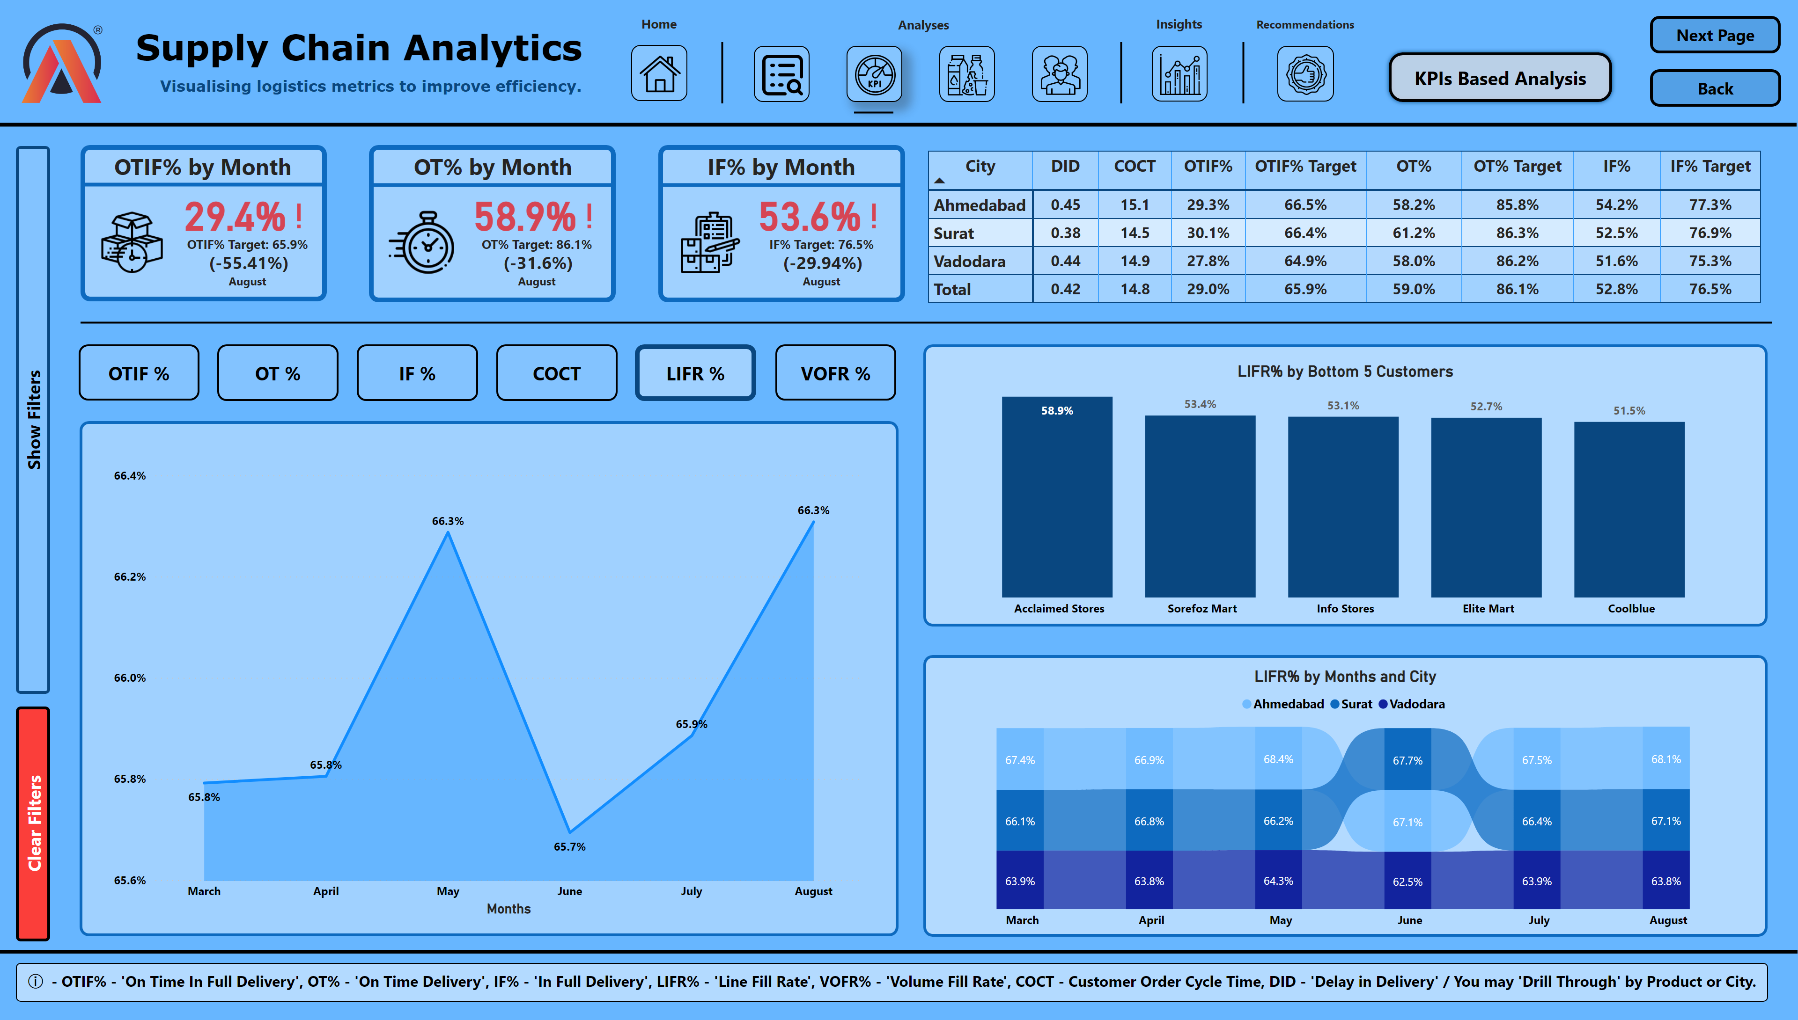
KPIs Based Analysis
Notes:
shape
No alt text provided
shape
No alt text provided
slicer
No alt text provided
slicer
No alt text provided
slicer
No alt text provided
slicer
No alt text provided
slicer
No alt text provided
slicer
No alt text provided
actionButton
No alt text provided
shape
No alt text provided
areaChart
No alt text provided
areaChart
No alt text provided
areaChart
No alt text provided
areaChart
No alt text provided
areaChart
No alt text provided
areaChart
No alt text provided
actionButton
No alt text provided
Performance Trend
No alt text provided
actionButton
No alt text provided
actionButton
No alt text provided
actionButton
No alt text provided
LIFR A
No alt text provided
actionButton
No alt text provided
OTIF I
No alt text provided
OT I
No alt text provided
IF I
No alt text provided
COCT I
No alt text provided
actionButton
No alt text provided
VOFR I
No alt text provided
textbox
No alt text provided
actionButton
No alt text provided
actionButton
No alt text provided
shape
No alt text provided
shape
No alt text provided
ribbonChart
No alt text provided
columnChart
No alt text provided
shape
No alt text provided
shape
No alt text provided
City wise DID, COCT, OTIF%, OT%, IF% vs their respective Targets
No alt text provided
OT% by Year
No alt text provided
IF% by Year
No alt text provided
image
No alt text provided
image
No alt text provided
image
No alt text provided
textbox
No alt text provided
textbox
No alt text provided
textbox
No alt text provided
shape
No alt text provided
OTIF% by Year
No alt text provided
shape
No alt text provided
shape
No alt text provided
shape
No alt text provided
shape
No alt text provided
shape
No alt text provided
shape
No alt text provided
columnChart
No alt text provided
ribbonChart
No alt text provided
columnChart
No alt text provided
ribbonChart
No alt text provided
columnChart
No alt text provided
ribbonChart
No alt text provided
LIFR% by Bottom 5 Customers
No alt text provided
ribbonChart
No alt text provided
columnChart
No alt text provided
ribbonChart
No alt text provided
image
No alt text provided
textbox
No alt text provided
textbox
No alt text provided
image
No alt text provided
image
No alt text provided
image
No alt text provided
image
No alt text provided
image
No alt text provided
actionButton
No alt text provided
actionButton
No alt text provided
image
No alt text provided
image
No alt text provided
textbox
No alt text provided
textbox
No alt text provided
textbox
No alt text provided
textbox
No alt text provided
shape
No alt text provided
shape
No alt text provided
shape
No alt text provided
shape
No alt text provided
shape
No alt text provided

Slide 5
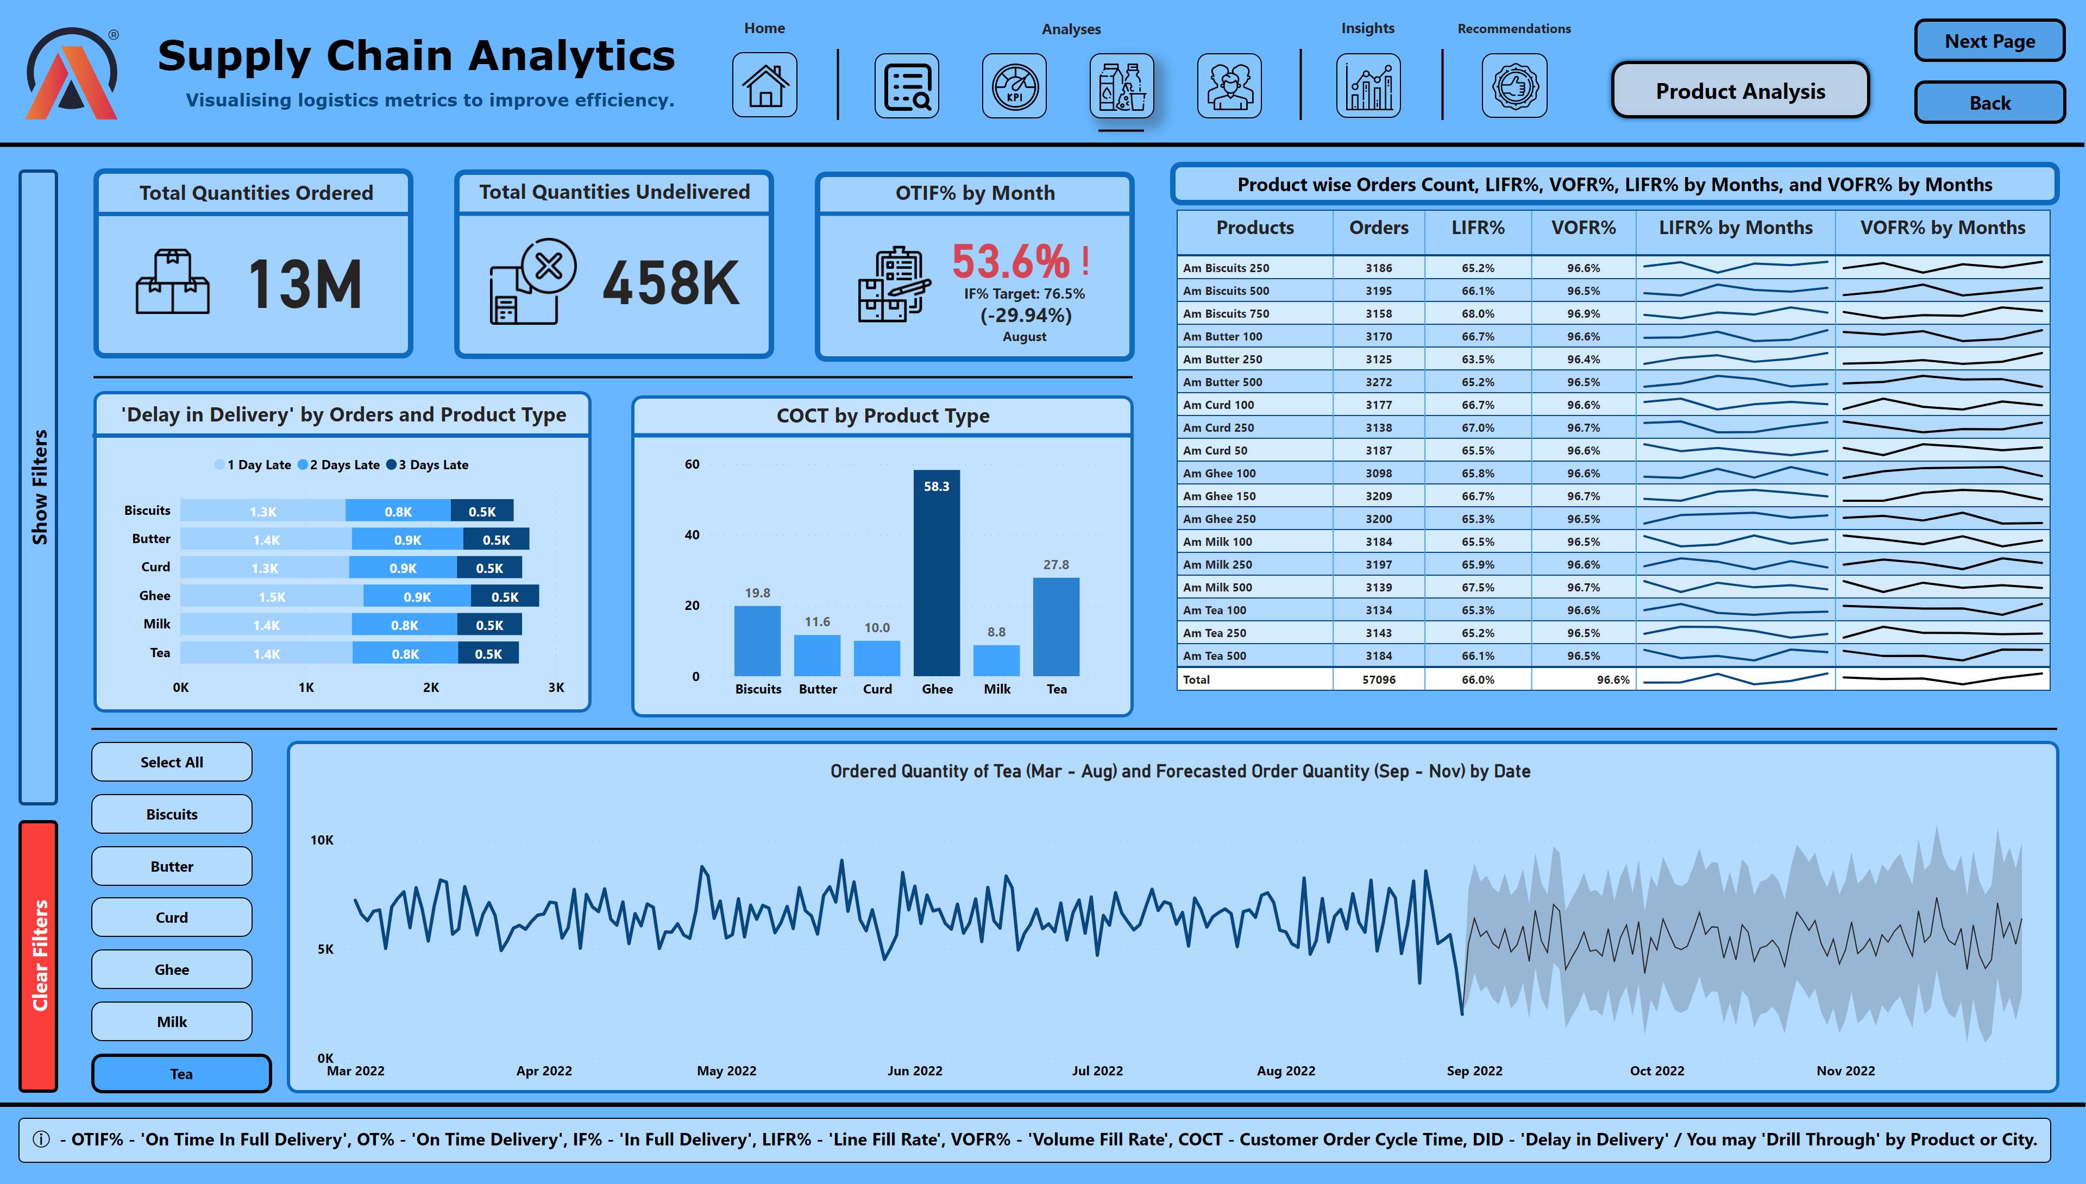
Product Analysis
Notes:
lineChart
No alt text provided
actionButton
No alt text provided
actionButton
No alt text provided
shape
No alt text provided
shape
No alt text provided
shape
No alt text provided
shape
No alt text provided
shape
No alt text provided
actionButton
No alt text provided
Select All IA
No alt text provided
Biscuits IA
No alt text provided
Butter IA
No alt text provided
Curd IA
No alt text provided
Ghee IA
No alt text provided
Milk IA
No alt text provided
actionButton
No alt text provided
Tea A
No alt text provided
actionButton
No alt text provided
actionButton
No alt text provided
actionButton
No alt text provided
actionButton
No alt text provided
actionButton
No alt text provided
lineChart
No alt text provided
lineChart
No alt text provided
lineChart
No alt text provided
lineChart
No alt text provided
lineChart
No alt text provided
lineChart
No alt text provided
Ordered Quantity of Tea (Mar - Aug) and Forecasted Order Quantity (Sep - Nov) by Date
No alt text provided
Product wise number of orders LIFR%, VOFR%, LIFR% by Months, and FR% by Months
No alt text provided
barChart
No alt text provided
columnChart
No alt text provided
textbox
No alt text provided
textbox
No alt text provided
textbox
No alt text provided
shape
No alt text provided
shape
No alt text provided
shape
No alt text provided
shape
No alt text provided
shape
No alt text provided
shape
No alt text provided
shape
No alt text provided
textbox
No alt text provided
textbox
No alt text provided
shape
No alt text provided
shape
No alt text provided
shape
No alt text provided
image
No alt text provided
IF% by Year
No alt text provided
IF% by Year
No alt text provided
IF% by Year
No alt text provided
image
No alt text provided
image
No alt text provided
shape
No alt text provided
shape
No alt text provided
shape
No alt text provided
image
No alt text provided
textbox
No alt text provided
textbox
No alt text provided
image
No alt text provided
image
No alt text provided
image
No alt text provided
image
No alt text provided
image
No alt text provided
actionButton
No alt text provided
actionButton
No alt text provided
image
No alt text provided
image
No alt text provided
textbox
No alt text provided
textbox
No alt text provided
textbox
No alt text provided
textbox
No alt text provided
shape
No alt text provided
shape
No alt text provided
shape
No alt text provided
shape
No alt text provided
shape
No alt text provided
textbox
No alt text provided

Slide 6
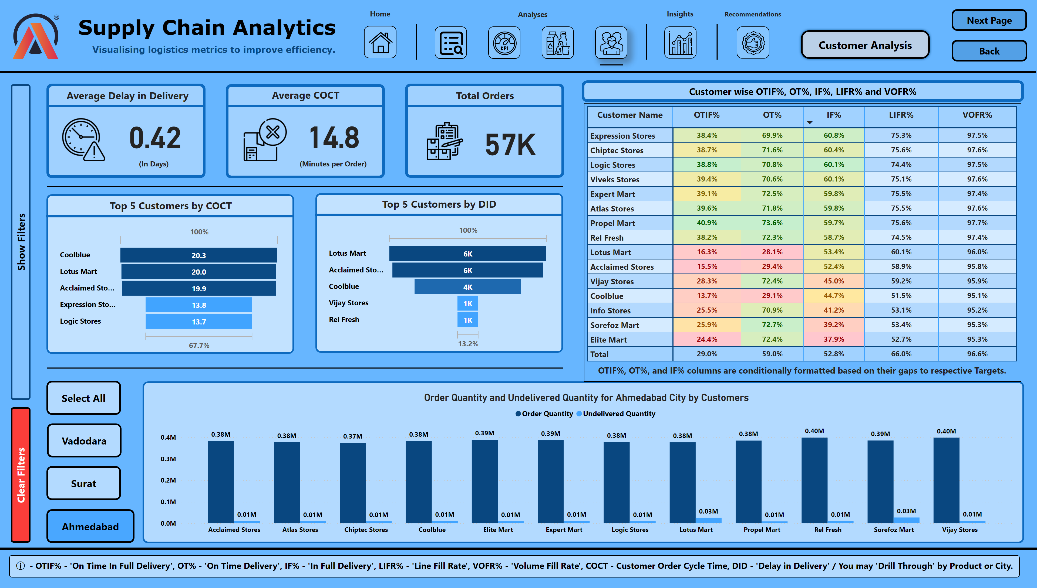
Customer Analysis
Notes:
pivotTable
No alt text provided
shape
No alt text provided
shape
No alt text provided
actionButton
No alt text provided
actionButton
No alt text provided
shape
No alt text provided
shape
No alt text provided
shape
No alt text provided
textbox
No alt text provided
funnel
No alt text provided
textbox
No alt text provided
textbox
No alt text provided
textbox
No alt text provided
shape
No alt text provided
shape
No alt text provided
shape
No alt text provided
shape
No alt text provided
shape
No alt text provided
shape
No alt text provided
image
No alt text provided
IF% by Year
No alt text provided
IF% by Year
No alt text provided
IF% by Year
No alt text provided
image
No alt text provided
shape
No alt text provided
shape
No alt text provided
textbox
No alt text provided
funnel
No alt text provided
shape
No alt text provided
shape
No alt text provided
textbox
No alt text provided
Ahmedabad A
No alt text provided
actionButton
No alt text provided
actionButton
No alt text provided
actionButton
No alt text provided
Vadodara IA
No alt text provided
Surat IA
No alt text provided
Select All IA
No alt text provided
actionButton
No alt text provided
clusteredColumnChart
No alt text provided
clusteredColumnChart
No alt text provided
clusteredColumnChart
No alt text provided
Order Quantity and Undelivered Quantity for Ahmedabad City by Customers
No alt text provided
shape
No alt text provided
shape
No alt text provided
shape
No alt text provided
textbox
No alt text provided
textbox
No alt text provided
image
No alt text provided
image
No alt text provided
textbox
No alt text provided
textbox
No alt text provided
image
No alt text provided
image
No alt text provided
image
No alt text provided
image
No alt text provided
image
No alt text provided
actionButton
No alt text provided
actionButton
No alt text provided
image
No alt text provided
image
No alt text provided
textbox
No alt text provided
textbox
No alt text provided
textbox
No alt text provided
textbox
No alt text provided
shape
No alt text provided
shape
No alt text provided
shape
No alt text provided
shape
No alt text provided
shape
No alt text provided
textbox
No alt text provided

Slide 7
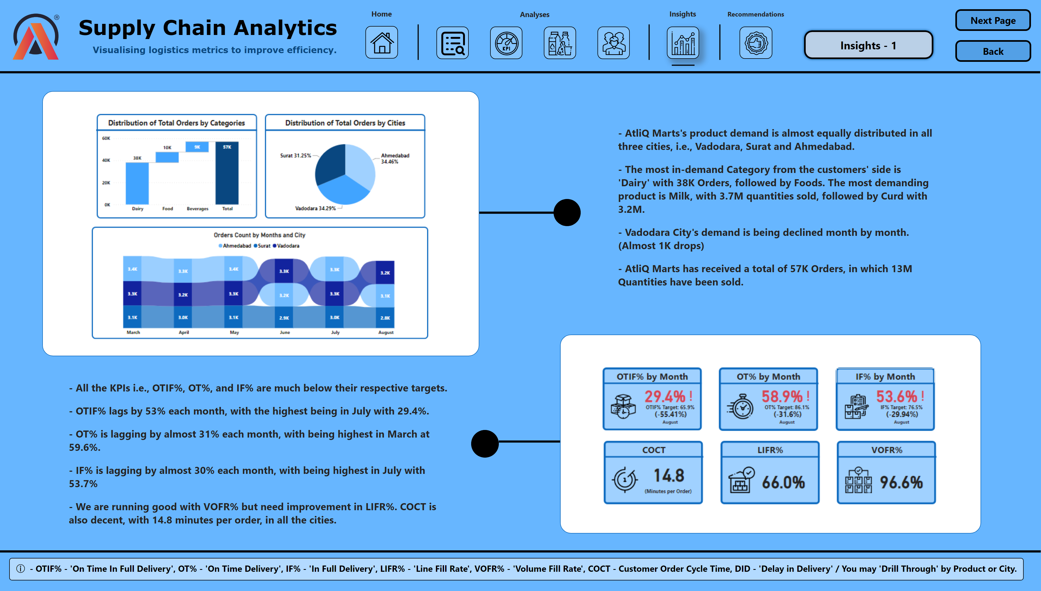
Insights - 1
Notes:
shape
No alt text provided
shape
No alt text provided
shape
No alt text provided
shape
No alt text provided
image
No alt text provided
image
No alt text provided
textbox
No alt text provided
textbox
No alt text provided
shape
No alt text provided
shape
No alt text provided
shape
No alt text provided
shape
No alt text provided
image
No alt text provided
textbox
No alt text provided
textbox
No alt text provided
image
No alt text provided
image
No alt text provided
image
No alt text provided
image
No alt text provided
image
No alt text provided
actionButton
No alt text provided
actionButton
No alt text provided
image
No alt text provided
image
No alt text provided
textbox
No alt text provided
textbox
No alt text provided
textbox
No alt text provided
textbox
No alt text provided
shape
No alt text provided
shape
No alt text provided
shape
No alt text provided
shape
No alt text provided
shape
No alt text provided
textbox
No alt text provided

Slide 8
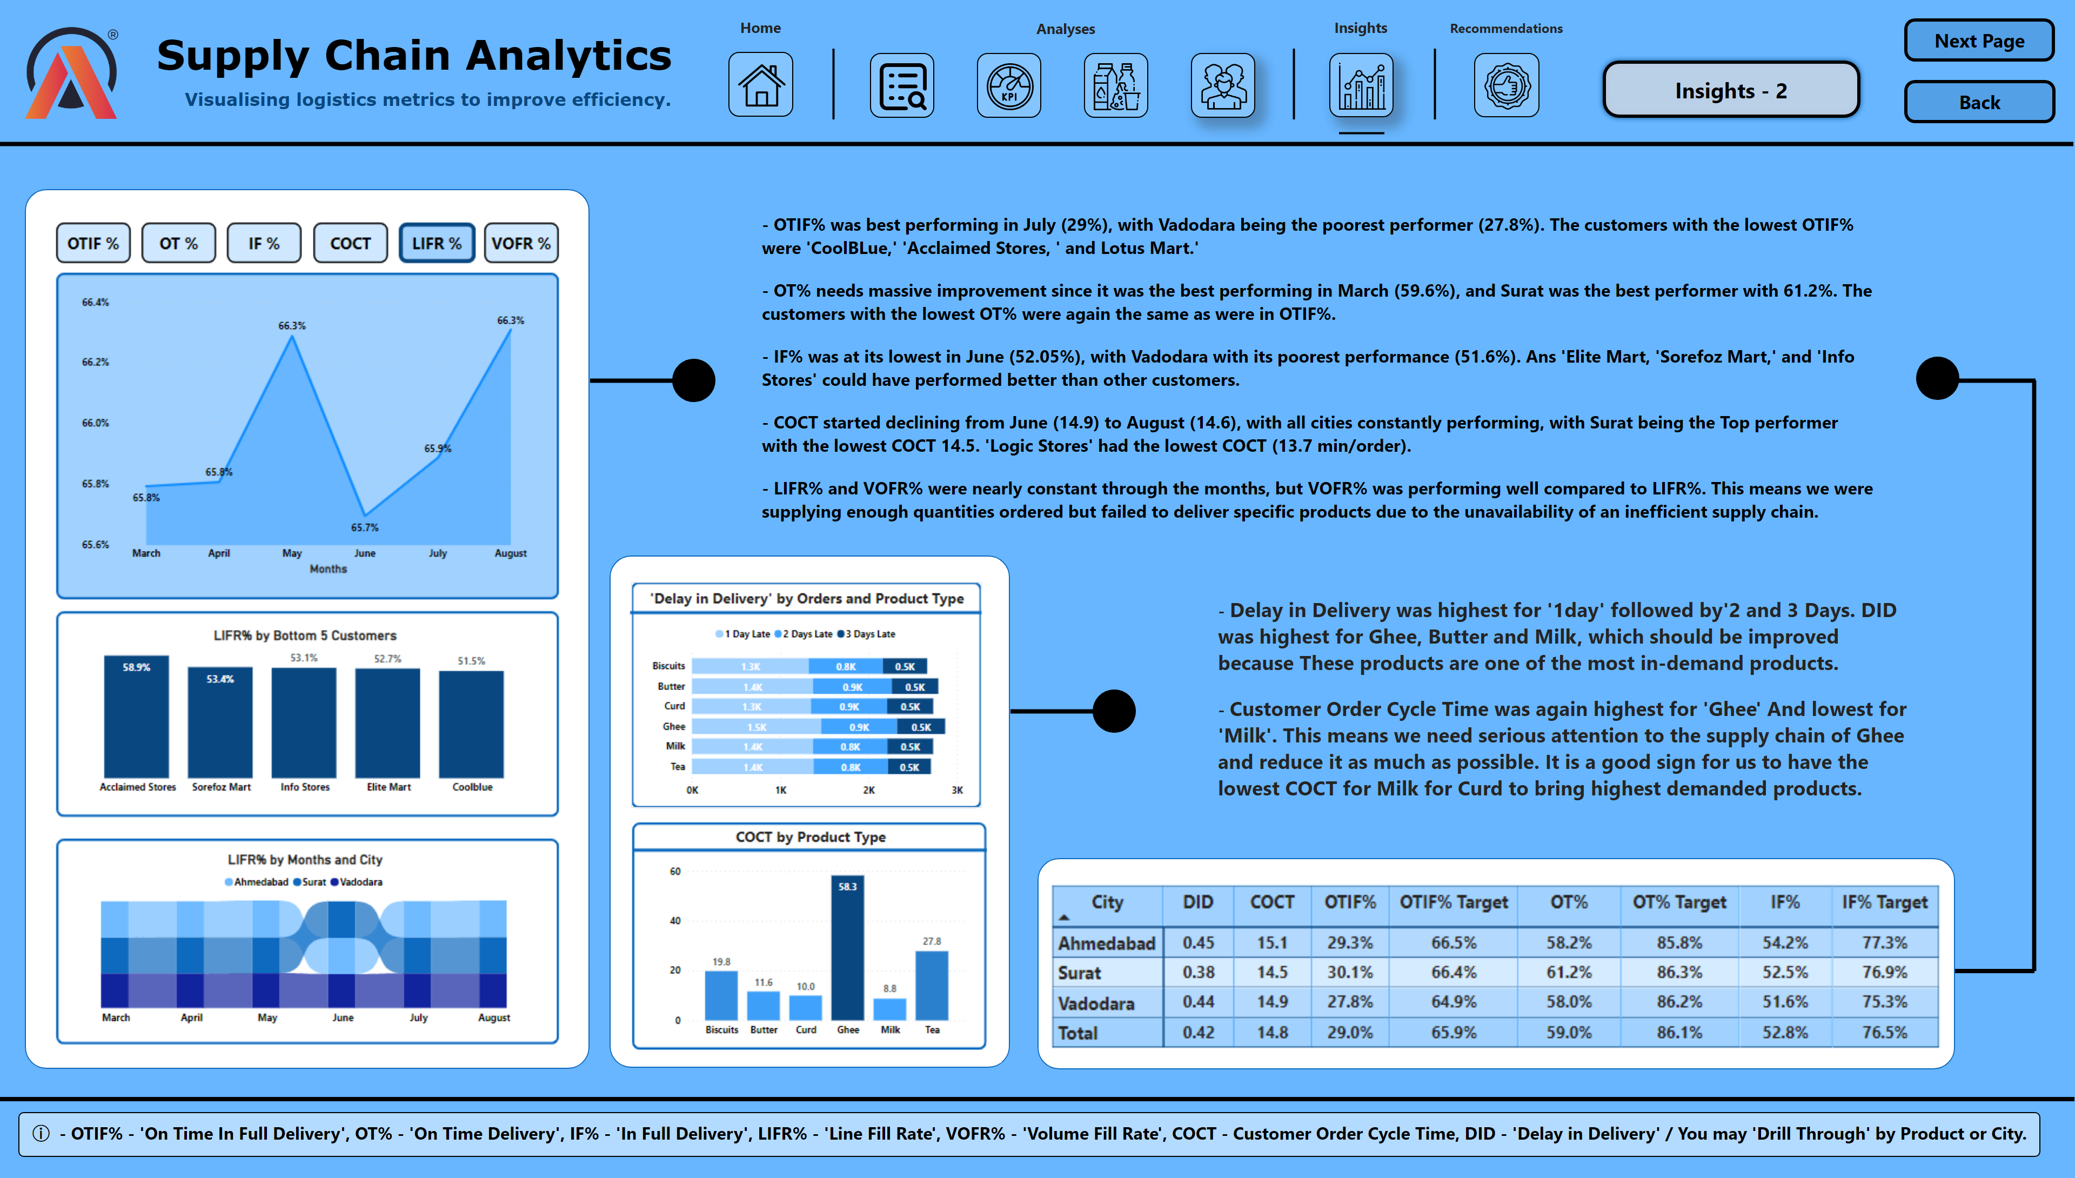
Insights - 2
Notes:
image
No alt text provided
shape
No alt text provided
shape
No alt text provided
shape
No alt text provided
shape
No alt text provided
image
No alt text provided
shape
No alt text provided
image
No alt text provided
textbox
No alt text provided
shape
No alt text provided
shape
No alt text provided
shape
No alt text provided
shape
No alt text provided
shape
No alt text provided
shape
No alt text provided
textbox
No alt text provided
shape
No alt text provided
shape
No alt text provided
image
No alt text provided
textbox
No alt text provided
textbox
No alt text provided
image
No alt text provided
image
No alt text provided
image
No alt text provided
image
No alt text provided
image
No alt text provided
actionButton
No alt text provided
actionButton
No alt text provided
image
No alt text provided
image
No alt text provided
textbox
No alt text provided
textbox
No alt text provided
textbox
No alt text provided
textbox
No alt text provided
shape
No alt text provided
shape
No alt text provided
shape
No alt text provided
shape
No alt text provided
shape
No alt text provided
textbox
No alt text provided

Slide 9
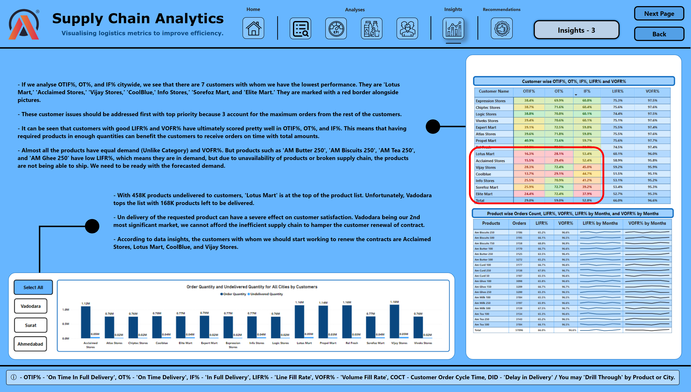
Insights - 3
Notes:
shape
No alt text provided
shape
No alt text provided
image
No alt text provided
shape
No alt text provided
shape
No alt text provided
shape
No alt text provided
textbox
No alt text provided
image
No alt text provided
textbox
No alt text provided
shape
No alt text provided
shape
No alt text provided
shape
No alt text provided
shape
No alt text provided
shape
No alt text provided
image
No alt text provided
textbox
No alt text provided
textbox
No alt text provided
image
No alt text provided
image
No alt text provided
image
No alt text provided
image
No alt text provided
image
No alt text provided
actionButton
No alt text provided
actionButton
No alt text provided
image
No alt text provided
image
No alt text provided
textbox
No alt text provided
textbox
No alt text provided
textbox
No alt text provided
textbox
No alt text provided
shape
No alt text provided
shape
No alt text provided
shape
No alt text provided
shape
No alt text provided
shape
No alt text provided
textbox
No alt text provided

Slide 10
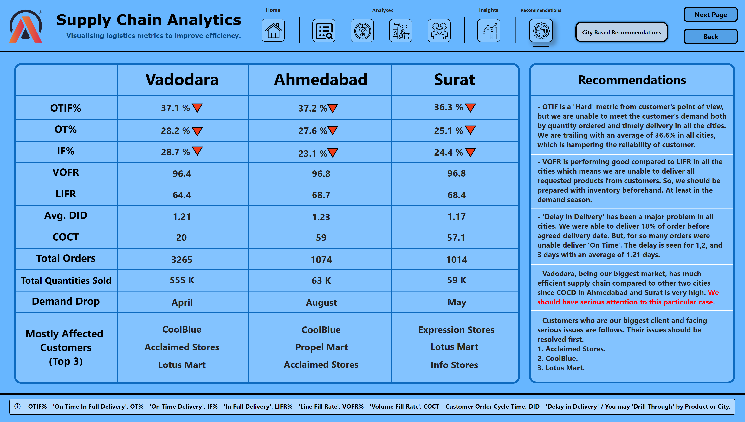
City Recommendations
Notes:
shape
No alt text provided
shape
No alt text provided
slicer
No alt text provided
slicer
No alt text provided
slicer
No alt text provided
slicer
No alt text provided
slicer
No alt text provided
slicer
No alt text provided
actionButton
No alt text provided
shape
No alt text provided
textbox
No alt text provided
shape
No alt text provided
textbox
No alt text provided
textbox
No alt text provided
textbox
No alt text provided
textbox
No alt text provided
textbox
No alt text provided
textbox
No alt text provided
textbox
No alt text provided
textbox
No alt text provided
textbox
No alt text provided
textbox
No alt text provided
textbox
No alt text provided
textbox
No alt text provided
textbox
No alt text provided
textbox
No alt text provided
shape
No alt text provided
shape
No alt text provided
shape
No alt text provided
shape
No alt text provided
shape
No alt text provided
shape
No alt text provided
shape
No alt text provided
shape
No alt text provided
shape
No alt text provided
shape
No alt text provided
shape
No alt text provided
shape
No alt text provided
shape
No alt text provided
shape
No alt text provided
textbox
No alt text provided
textbox
No alt text provided
textbox
No alt text provided
textbox
No alt text provided
textbox
No alt text provided
textbox
No alt text provided
textbox
No alt text provided
textbox
No alt text provided
textbox
No alt text provided
textbox
No alt text provided
textbox
No alt text provided
textbox
No alt text provided
textbox
No alt text provided
textbox
No alt text provided
textbox
No alt text provided
textbox
No alt text provided
textbox
No alt text provided
textbox
No alt text provided
textbox
No alt text provided
textbox
No alt text provided
textbox
No alt text provided
textbox
No alt text provided
textbox
No alt text provided
textbox
No alt text provided
textbox
No alt text provided
textbox
No alt text provided
textbox
No alt text provided
textbox
No alt text provided
textbox
No alt text provided
textbox
No alt text provided
textbox
No alt text provided
textbox
No alt text provided
textbox
No alt text provided
textbox
No alt text provided
textbox
No alt text provided
textbox
No alt text provided
textbox
No alt text provided
textbox
No alt text provided
textbox
No alt text provided
textbox
No alt text provided
textbox
No alt text provided
textbox
No alt text provided
textbox
No alt text provided
textbox
No alt text provided
textbox
No alt text provided
textbox
No alt text provided
textbox
No alt text provided
textbox
No alt text provided
shape
No alt text provided
textbox
No alt text provided
shape
No alt text provided
textbox
No alt text provided
textbox
No alt text provided
textbox
No alt text provided
textbox
No alt text provided
textbox
No alt text provided
shape
No alt text provided
shape
No alt text provided
shape
No alt text provided
shape
No alt text provided
image
No alt text provided
textbox
No alt text provided
textbox
No alt text provided
image
No alt text provided
image
No alt text provided
image
No alt text provided
image
No alt text provided
image
No alt text provided
actionButton
No alt text provided
actionButton
No alt text provided
image
No alt text provided
image
No alt text provided
textbox
No alt text provided
textbox
No alt text provided
textbox
No alt text provided
textbox
No alt text provided
shape
No alt text provided
shape
No alt text provided
shape
No alt text provided
shape
No alt text provided
shape
No alt text provided

Slide 11
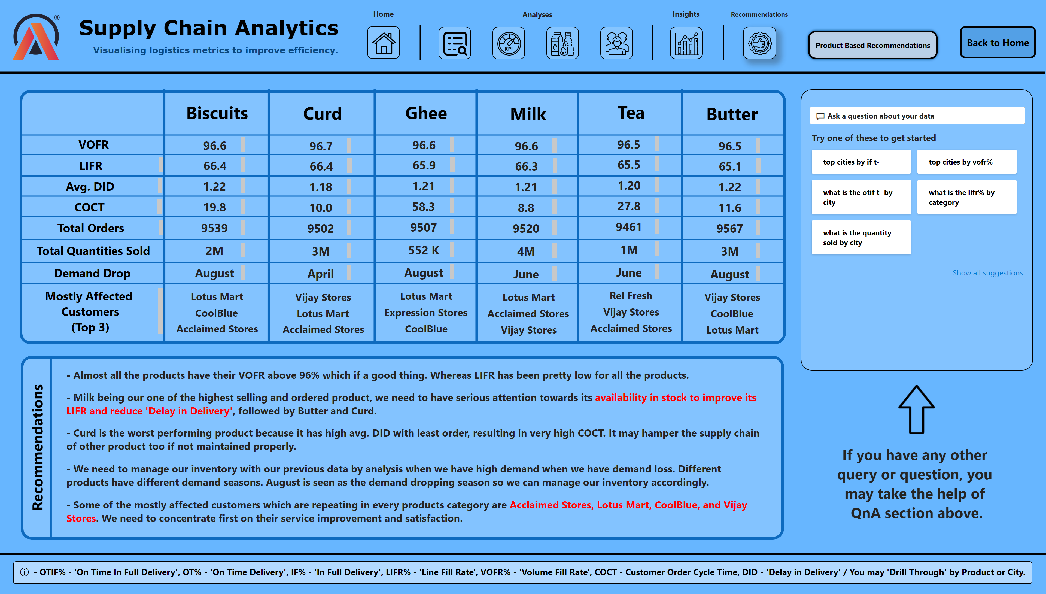
Product Recommendations
Notes:
shape
No alt text provided
shape
No alt text provided
slicer
No alt text provided
slicer
No alt text provided
slicer
No alt text provided
slicer
No alt text provided
slicer
No alt text provided
slicer
No alt text provided
actionButton
No alt text provided
shape
No alt text provided
shape
No alt text provided
textbox
No alt text provided
textbox
No alt text provided
textbox
No alt text provided
textbox
No alt text provided
textbox
No alt text provided
textbox
No alt text provided
textbox
No alt text provided
textbox
No alt text provided
textbox
No alt text provided
shape
No alt text provided
shape
No alt text provided
shape
No alt text provided
shape
No alt text provided
shape
No alt text provided
shape
No alt text provided
shape
No alt text provided
shape
No alt text provided
shape
No alt text provided
shape
No alt text provided
textbox
No alt text provided
textbox
No alt text provided
textbox
No alt text provided
textbox
No alt text provided
textbox
No alt text provided
textbox
No alt text provided
textbox
No alt text provided
textbox
No alt text provided
textbox
No alt text provided
textbox
No alt text provided
textbox
No alt text provided
textbox
No alt text provided
textbox
No alt text provided
textbox
No alt text provided
textbox
No alt text provided
textbox
No alt text provided
textbox
No alt text provided
textbox
No alt text provided
textbox
No alt text provided
textbox
No alt text provided
textbox
No alt text provided
textbox
No alt text provided
textbox
No alt text provided
textbox
No alt text provided
textbox
No alt text provided
textbox
No alt text provided
textbox
No alt text provided
textbox
No alt text provided
textbox
No alt text provided
textbox
No alt text provided
textbox
No alt text provided
textbox
No alt text provided
textbox
No alt text provided
textbox
No alt text provided
textbox
No alt text provided
textbox
No alt text provided
textbox
No alt text provided
textbox
No alt text provided
textbox
No alt text provided
textbox
No alt text provided
textbox
No alt text provided
textbox
No alt text provided
textbox
No alt text provided
textbox
No alt text provided
textbox
No alt text provided
textbox
No alt text provided
textbox
No alt text provided
textbox
No alt text provided
textbox
No alt text provided
textbox
No alt text provided
textbox
No alt text provided
textbox
No alt text provided
textbox
No alt text provided
textbox
No alt text provided
shape
No alt text provided
shape
No alt text provided
shape
No alt text provided
shape
No alt text provided
textbox
No alt text provided
textbox
No alt text provided
textbox
No alt text provided
textbox
No alt text provided
textbox
No alt text provided
textbox
No alt text provided
textbox
No alt text provided
textbox
No alt text provided
textbox
No alt text provided
textbox
No alt text provided
textbox
No alt text provided
textbox
No alt text provided
qnaVisual
No alt text provided
shape
No alt text provided
shape
No alt text provided
shape
No alt text provided
textbox
No alt text provided
textbox
No alt text provided
textbox
No alt text provided
textbox
No alt text provided
textbox
No alt text provided
textbox
No alt text provided
image
No alt text provided
image
No alt text provided
textbox
No alt text provided
textbox
No alt text provided
image
No alt text provided
image
No alt text provided
image
No alt text provided
image
No alt text provided
image
No alt text provided
actionButton
No alt text provided
image
No alt text provided
image
No alt text provided
textbox
No alt text provided
textbox
No alt text provided
textbox
No alt text provided
textbox
No alt text provided
shape
No alt text provided
shape
No alt text provided
shape
No alt text provided
shape
No alt text provided

Slide 12
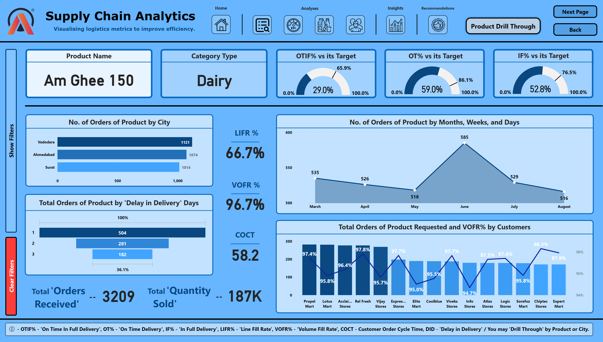
Product Drill Through
Notes:
card
No alt text provided
card
No alt text provided
barChart
No alt text provided
gauge
No alt text provided
gauge
No alt text provided
card
No alt text provided
card
No alt text provided
shape
No alt text provided
shape
No alt text provided
slicer
No alt text provided
slicer
No alt text provided
slicer
No alt text provided
slicer
No alt text provided
slicer
No alt text provided
slicer
No alt text provided
actionButton
No alt text provided
shape
No alt text provided
shape
No alt text provided
shape
No alt text provided
shape
No alt text provided
gauge
No alt text provided
shape
No alt text provided
shape
No alt text provided
areaChart
No alt text provided
funnel
No alt text provided
lineStackedColumnComboChart
No alt text provided
textbox
No alt text provided
textbox
No alt text provided
textbox
No alt text provided
textbox
No alt text provided
shape
No alt text provided
shape
No alt text provided
shape
No alt text provided
shape
No alt text provided
shape
No alt text provided
shape
No alt text provided
shape
No alt text provided
shape
No alt text provided
shape
No alt text provided
shape
No alt text provided
shape
No alt text provided
shape
No alt text provided
shape
No alt text provided
shape
No alt text provided
textbox
No alt text provided
textbox
No alt text provided
textbox
No alt text provided
textbox
No alt text provided
textbox
No alt text provided
textbox
No alt text provided
textbox
No alt text provided
textbox
No alt text provided
textbox
No alt text provided
textbox
No alt text provided
shape
No alt text provided
card
No alt text provided
textbox
No alt text provided
shape
No alt text provided
card
No alt text provided
textbox
No alt text provided
shape
No alt text provided
card
No alt text provided
textbox
No alt text provided
actionButton
No alt text provided
actionButton
No alt text provided
shape
No alt text provided
shape
No alt text provided
image
No alt text provided
textbox
No alt text provided
textbox
No alt text provided
image
No alt text provided
image
No alt text provided
image
No alt text provided
image
No alt text provided
image
No alt text provided
actionButton
No alt text provided
actionButton
No alt text provided
image
No alt text provided
image
No alt text provided
textbox
No alt text provided
textbox
No alt text provided
textbox
No alt text provided
textbox
No alt text provided
shape
No alt text provided
shape
No alt text provided
shape
No alt text provided
shape
No alt text provided

Slide 13
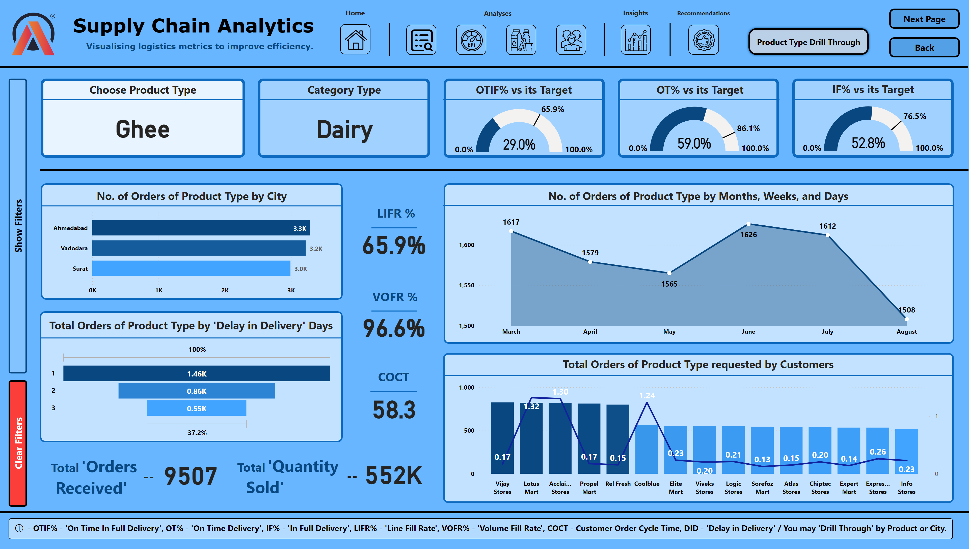
Product Type Drill Through
Notes:
shape
No alt text provided
shape
No alt text provided
slicer
No alt text provided
slicer
No alt text provided
slicer
No alt text provided
slicer
No alt text provided
slicer
No alt text provided
slicer
No alt text provided
actionButton
No alt text provided
shape
No alt text provided
card
No alt text provided
barChart
No alt text provided
gauge
No alt text provided
gauge
No alt text provided
card
No alt text provided
card
No alt text provided
shape
No alt text provided
shape
No alt text provided
shape
No alt text provided
gauge
No alt text provided
shape
No alt text provided
shape
No alt text provided
areaChart
No alt text provided
funnel
No alt text provided
lineStackedColumnComboChart
No alt text provided
textbox
No alt text provided
textbox
No alt text provided
textbox
No alt text provided
textbox
No alt text provided
shape
No alt text provided
shape
No alt text provided
shape
No alt text provided
shape
No alt text provided
shape
No alt text provided
shape
No alt text provided
shape
No alt text provided
shape
No alt text provided
shape
No alt text provided
shape
No alt text provided
shape
No alt text provided
shape
No alt text provided
shape
No alt text provided
shape
No alt text provided
textbox
No alt text provided
textbox
No alt text provided
textbox
No alt text provided
textbox
No alt text provided
textbox
No alt text provided
textbox
No alt text provided
textbox
No alt text provided
textbox
No alt text provided
textbox
No alt text provided
textbox
No alt text provided
shape
No alt text provided
card
No alt text provided
textbox
No alt text provided
shape
No alt text provided
card
No alt text provided
textbox
No alt text provided
shape
No alt text provided
card
No alt text provided
textbox
No alt text provided
actionButton
No alt text provided
actionButton
No alt text provided
shape
No alt text provided
shape
No alt text provided
card
No alt text provided
image
No alt text provided
textbox
No alt text provided
textbox
No alt text provided
image
No alt text provided
image
No alt text provided
image
No alt text provided
image
No alt text provided
image
No alt text provided
actionButton
No alt text provided
actionButton
No alt text provided
image
No alt text provided
image
No alt text provided
textbox
No alt text provided
textbox
No alt text provided
textbox
No alt text provided
textbox
No alt text provided
shape
No alt text provided
shape
No alt text provided
shape
No alt text provided
shape
No alt text provided

Slide 14
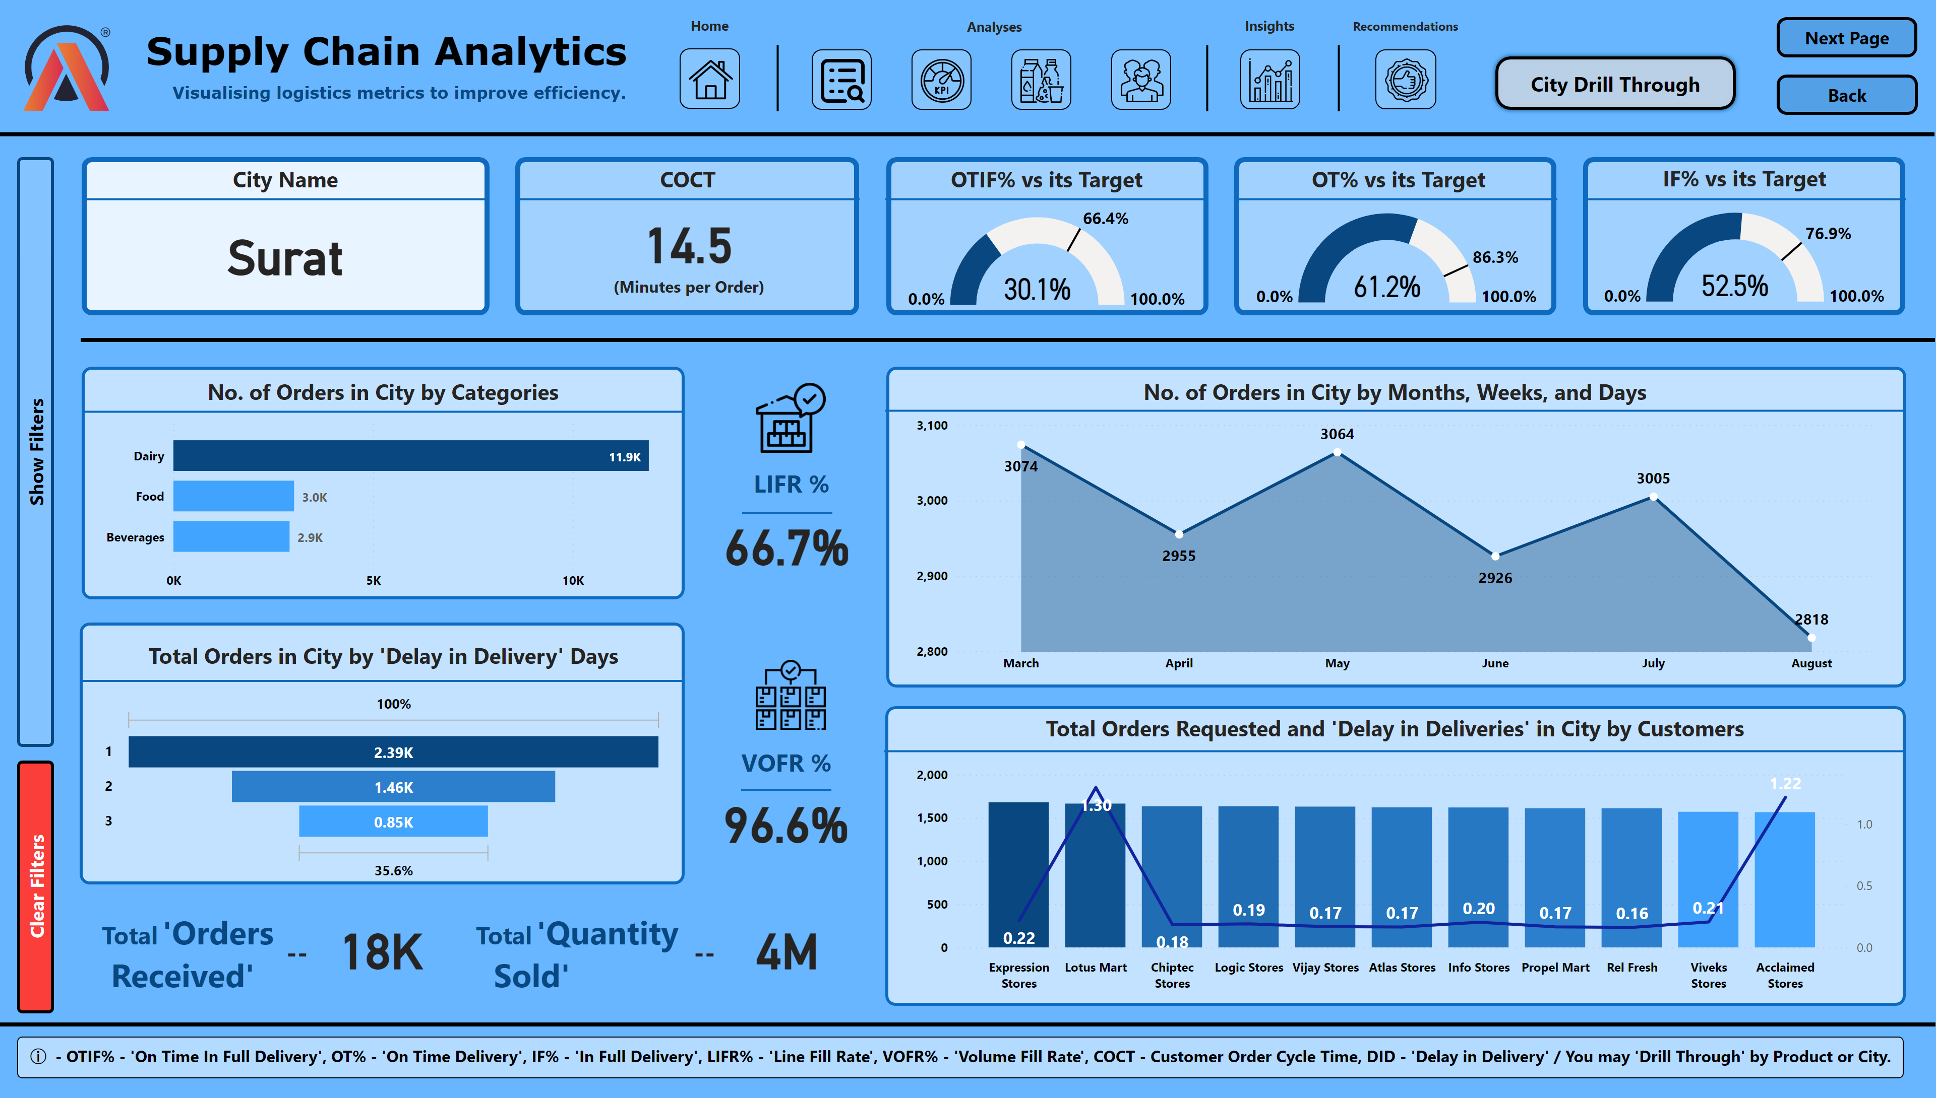
City Drill Through
Notes:
shape
No alt text provided
shape
No alt text provided
slicer
No alt text provided
slicer
No alt text provided
slicer
No alt text provided
slicer
No alt text provided
slicer
No alt text provided
slicer
No alt text provided
actionButton
No alt text provided
shape
No alt text provided
card
No alt text provided
card
No alt text provided
barChart
No alt text provided
gauge
No alt text provided
gauge
No alt text provided
card
No alt text provided
card
No alt text provided
shape
No alt text provided
shape
No alt text provided
shape
No alt text provided
gauge
No alt text provided
shape
No alt text provided
shape
No alt text provided
areaChart
No alt text provided
funnel
No alt text provided
lineStackedColumnComboChart
No alt text provided
textbox
No alt text provided
textbox
No alt text provided
textbox
No alt text provided
textbox
No alt text provided
shape
No alt text provided
shape
No alt text provided
shape
No alt text provided
shape
No alt text provided
shape
No alt text provided
shape
No alt text provided
shape
No alt text provided
shape
No alt text provided
shape
No alt text provided
shape
No alt text provided
shape
No alt text provided
shape
No alt text provided
shape
No alt text provided
textbox
No alt text provided
textbox
No alt text provided
textbox
No alt text provided
textbox
No alt text provided
textbox
No alt text provided
textbox
No alt text provided
textbox
No alt text provided
textbox
No alt text provided
textbox
No alt text provided
textbox
No alt text provided
shape
No alt text provided
textbox
No alt text provided
shape
No alt text provided
card
No alt text provided
textbox
No alt text provided
shape
No alt text provided
card
No alt text provided
image
No alt text provided
image
No alt text provided
textbox
No alt text provided
actionButton
No alt text provided
actionButton
No alt text provided
shape
No alt text provided
shape
No alt text provided
image
No alt text provided
textbox
No alt text provided
textbox
No alt text provided
image
No alt text provided
image
No alt text provided
image
No alt text provided
image
No alt text provided
image
No alt text provided
actionButton
No alt text provided
actionButton
No alt text provided
image
No alt text provided
image
No alt text provided
textbox
No alt text provided
textbox
No alt text provided
textbox
No alt text provided
textbox
No alt text provided
shape
No alt text provided
shape
No alt text provided
shape
No alt text provided
shape
No alt text provided

Slide 15
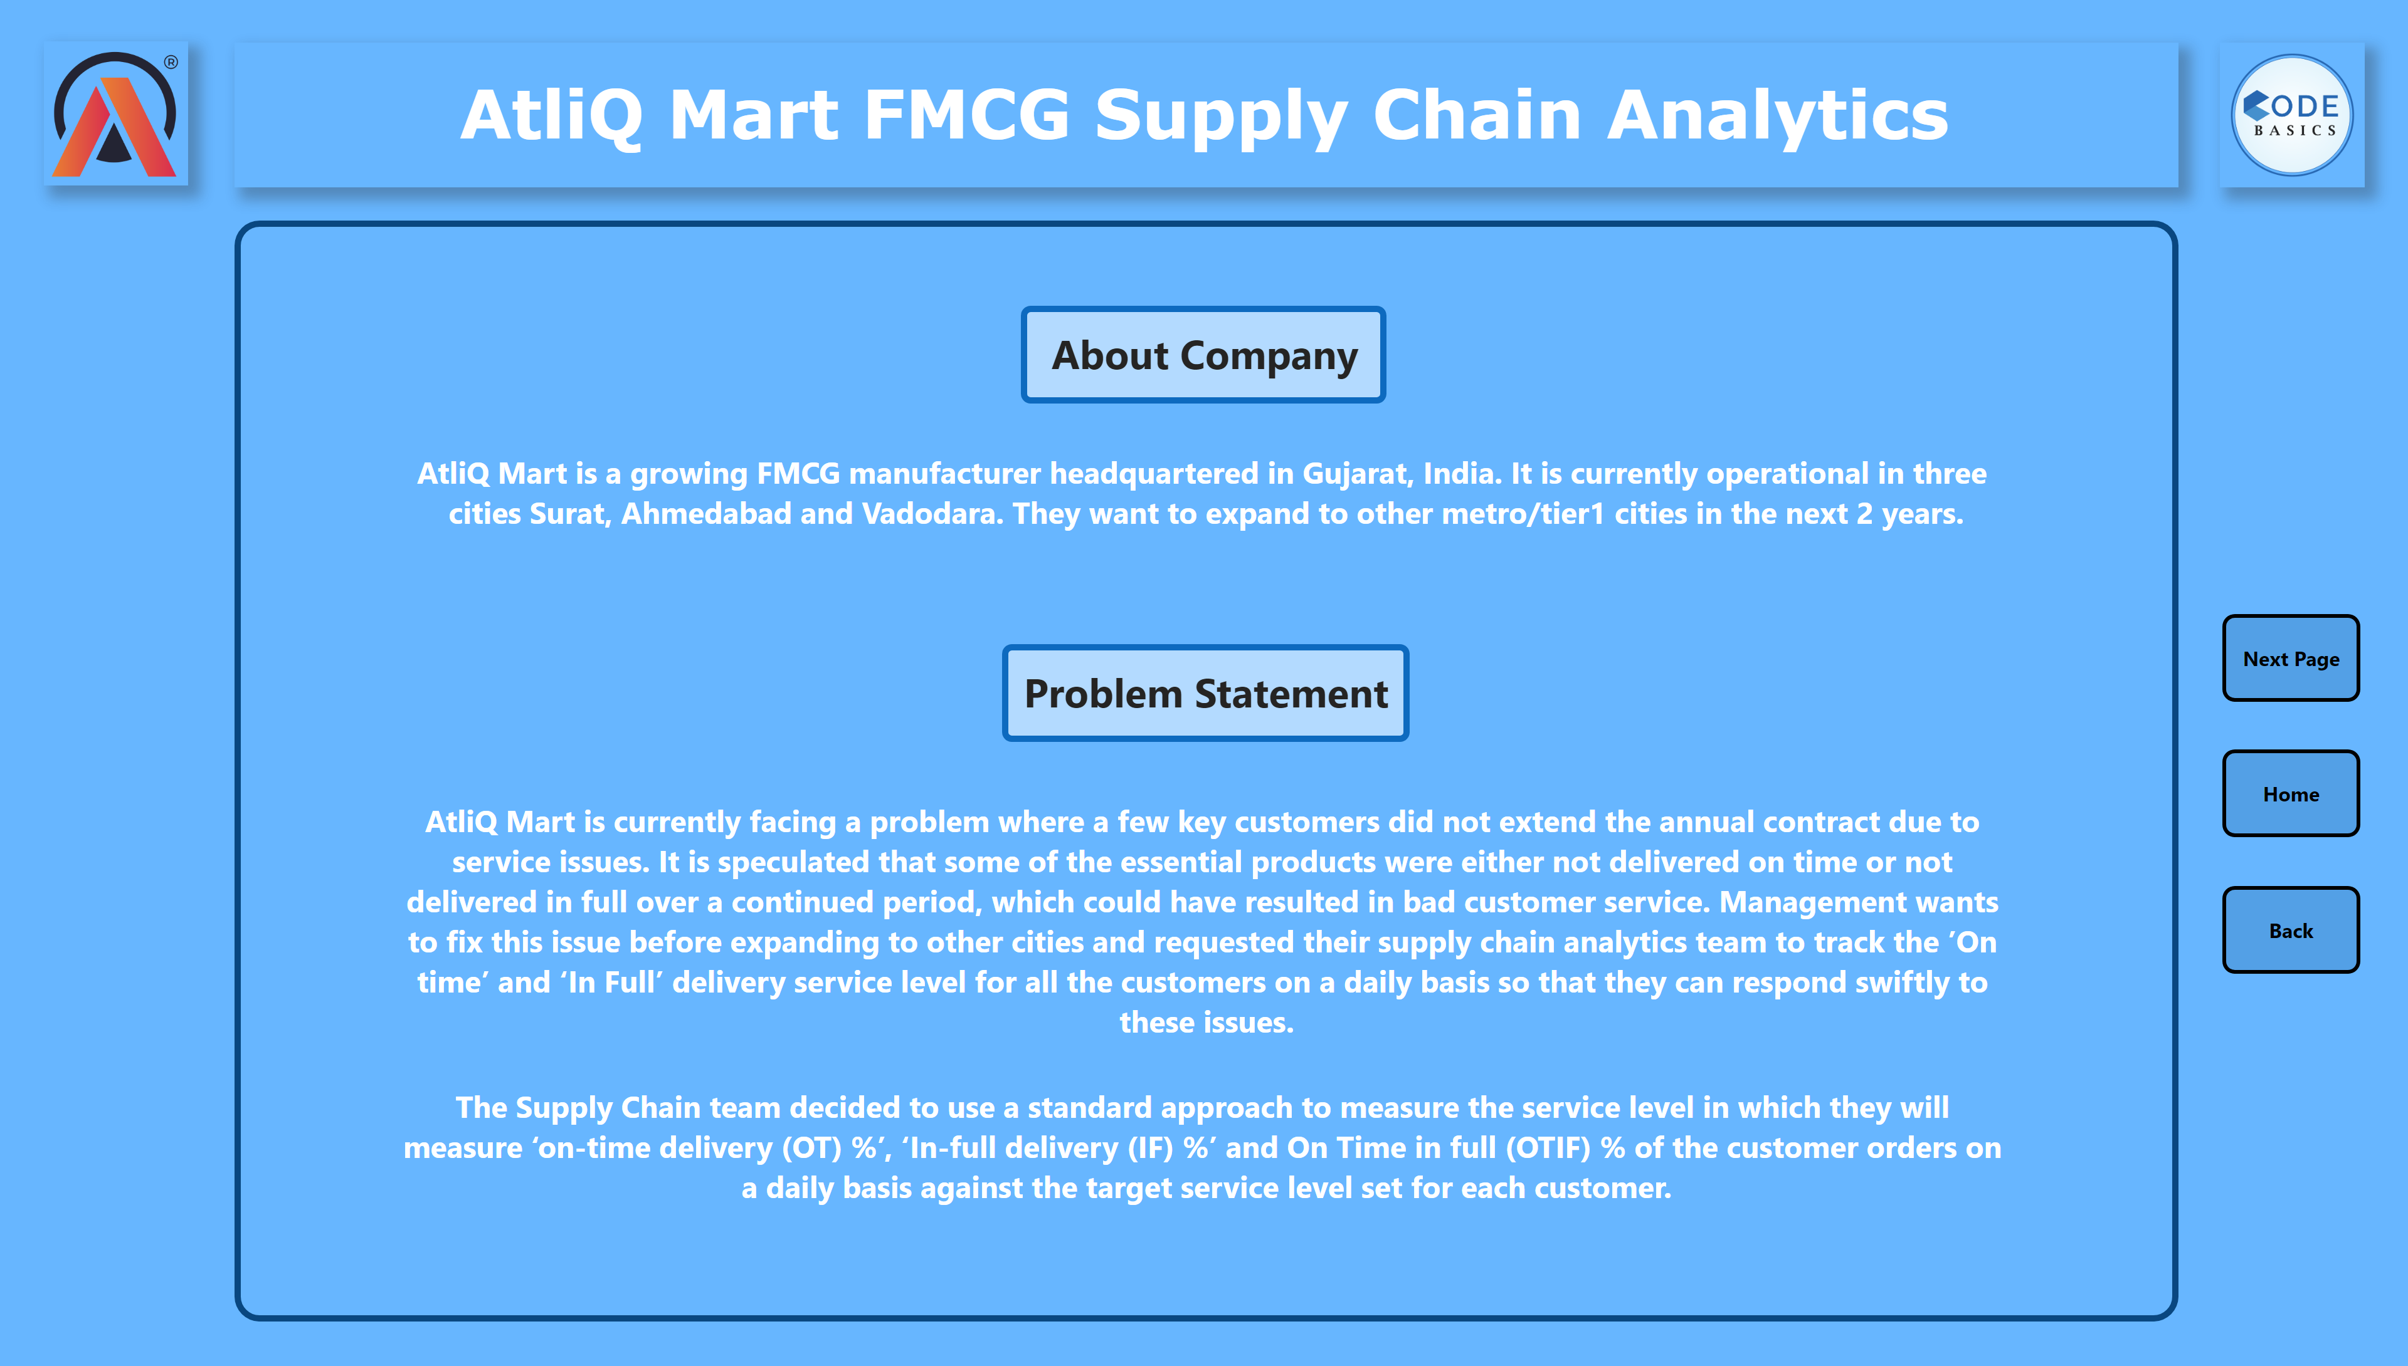
BG - AC & PS
Notes:
textbox
No alt text provided
shape
No alt text provided
image
No alt text provided
image
No alt text provided
textbox
No alt text provided
textbox
No alt text provided
textbox
No alt text provided
textbox
No alt text provided
shape
No alt text provided
shape
No alt text provided
shape
No alt text provided
actionButton
No alt text provided
actionButton
No alt text provided
actionButton
No alt text provided

Slide 16
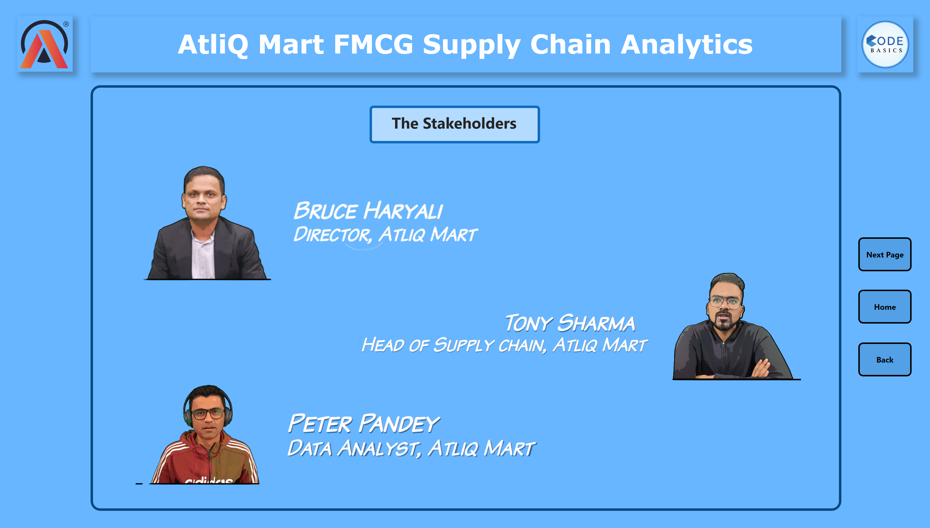
BG - TS
Notes:
textbox
No alt text provided
shape
No alt text provided
image
No alt text provided
image
No alt text provided
textbox
No alt text provided
shape
No alt text provided
actionButton
No alt text provided
actionButton
No alt text provided
actionButton
No alt text provided
shape
No alt text provided
image
No alt text provided
image
No alt text provided
image
No alt text provided
image
No alt text provided
image
No alt text provided
image
No alt text provided

Slide 17
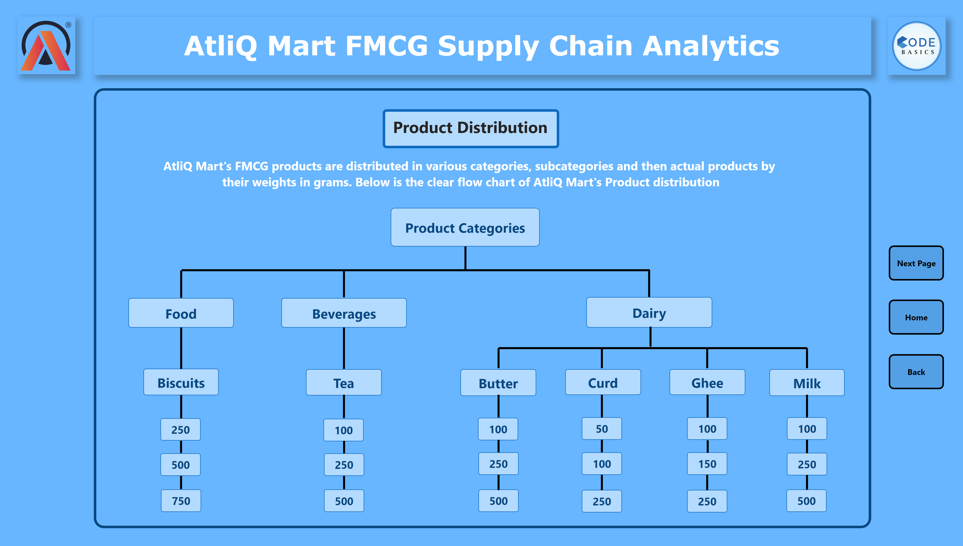
BG - PD
Notes:
textbox
No alt text provided
shape
No alt text provided
image
No alt text provided
image
No alt text provided
textbox
No alt text provided
shape
No alt text provided
shape
No alt text provided
shape
No alt text provided
shape
No alt text provided
shape
No alt text provided
shape
No alt text provided
shape
No alt text provided
shape
No alt text provided
shape
No alt text provided
shape
No alt text provided
shape
No alt text provided
shape
No alt text provided
shape
No alt text provided
shape
No alt text provided
shape
No alt text provided
shape
No alt text provided
shape
No alt text provided
shape
No alt text provided
shape
No alt text provided
shape
No alt text provided
shape
No alt text provided
shape
No alt text provided
shape
No alt text provided
shape
No alt text provided
shape
No alt text provided
shape
No alt text provided
shape
No alt text provided
shape
No alt text provided
shape
No alt text provided
shape
No alt text provided
shape
No alt text provided
shape
No alt text provided
shape
No alt text provided
shape
No alt text provided
shape
No alt text provided
shape
No alt text provided
shape
No alt text provided
shape
No alt text provided
shape
No alt text provided
shape
No alt text provided
shape
No alt text provided
shape
No alt text provided
shape
No alt text provided
shape
No alt text provided
shape
No alt text provided
shape
No alt text provided
shape
No alt text provided
shape
No alt text provided
shape
No alt text provided
shape
No alt text provided
shape
No alt text provided
shape
No alt text provided
shape
No alt text provided
shape
No alt text provided
shape
No alt text provided
shape
No alt text provided
shape
No alt text provided
shape
No alt text provided
shape
No alt text provided
textbox
No alt text provided
shape
No alt text provided
shape
No alt text provided
actionButton
No alt text provided
actionButton
No alt text provided
actionButton
No alt text provided

Slide 18
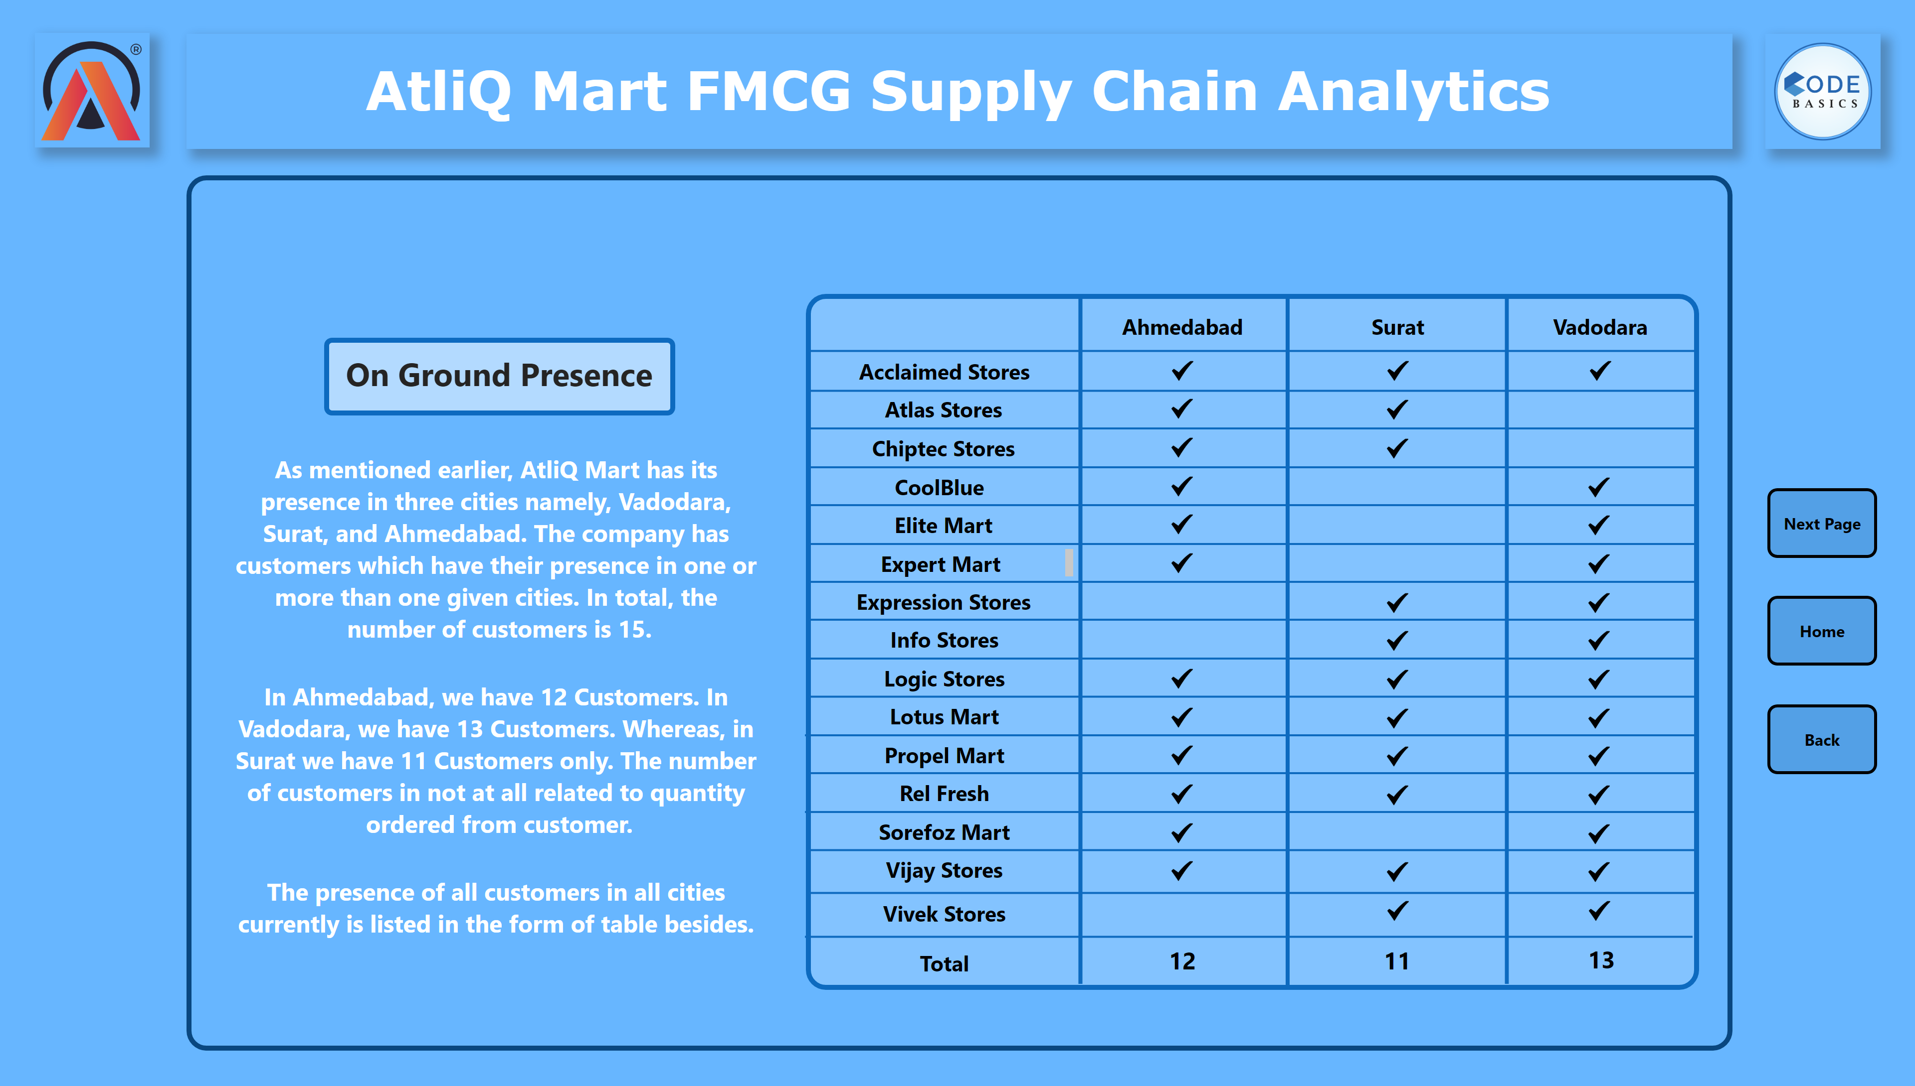
BG - OGP
Notes:
shape
No alt text provided
shape
No alt text provided
shape
No alt text provided
shape
No alt text provided
textbox
No alt text provided
shape
No alt text provided
shape
No alt text provided
textbox
No alt text provided
textbox
No alt text provided
textbox
No alt text provided
textbox
No alt text provided
textbox
No alt text provided
textbox
No alt text provided
textbox
No alt text provided
textbox
No alt text provided
textbox
No alt text provided
textbox
No alt text provided
textbox
No alt text provided
textbox
No alt text provided
textbox
No alt text provided
shape
No alt text provided
shape
No alt text provided
shape
No alt text provided
shape
No alt text provided
shape
No alt text provided
shape
No alt text provided
shape
No alt text provided
shape
No alt text provided
shape
No alt text provided
shape
No alt text provided
shape
No alt text provided
shape
No alt text provided
textbox
No alt text provided
textbox
No alt text provided
textbox
No alt text provided
image
No alt text provided
image
No alt text provided
image
No alt text provided
textbox
No alt text provided
shape
No alt text provided
image
No alt text provided
image
No alt text provided
image
No alt text provided
image
No alt text provided
image
No alt text provided
image
No alt text provided
image
No alt text provided
image
No alt text provided
image
No alt text provided
image
No alt text provided
image
No alt text provided
image
No alt text provided
image
No alt text provided
image
No alt text provided
image
No alt text provided
image
No alt text provided
image
No alt text provided
image
No alt text provided
image
No alt text provided
image
No alt text provided
image
No alt text provided
image
No alt text provided
image
No alt text provided
image
No alt text provided
image
No alt text provided
image
No alt text provided
image
No alt text provided
image
No alt text provided
image
No alt text provided
image
No alt text provided
image
No alt text provided
image
No alt text provided
image
No alt text provided
shape
No alt text provided
textbox
No alt text provided
textbox
No alt text provided
textbox
No alt text provided
textbox
No alt text provided
textbox
No alt text provided
shape
No alt text provided
image
No alt text provided
image
No alt text provided
textbox
No alt text provided
textbox
No alt text provided
shape
No alt text provided
shape
No alt text provided
actionButton
No alt text provided
actionButton
No alt text provided
actionButton
No alt text provided

Slide 19
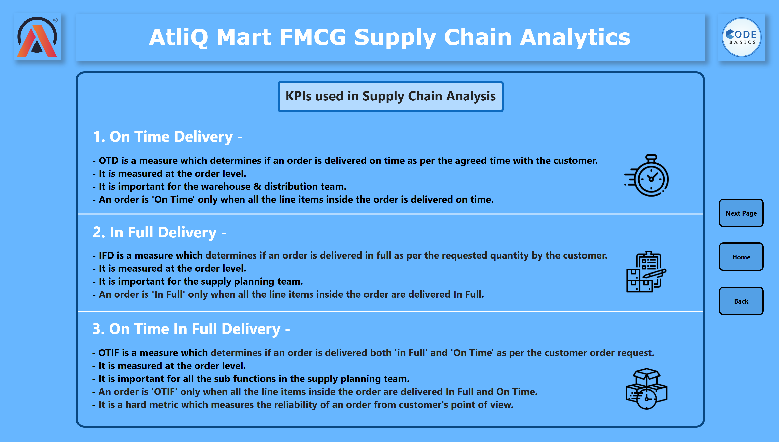
BG - KPIs - 1
Notes:
textbox
No alt text provided
shape
No alt text provided
image
No alt text provided
image
No alt text provided
textbox
No alt text provided
textbox
No alt text provided
textbox
No alt text provided
textbox
No alt text provided
textbox
No alt text provided
textbox
No alt text provided
textbox
No alt text provided
shape
No alt text provided
shape
No alt text provided
shape
No alt text provided
image
No alt text provided
image
No alt text provided
image
No alt text provided
shape
No alt text provided
actionButton
No alt text provided
actionButton
No alt text provided
actionButton
No alt text provided

Slide 20
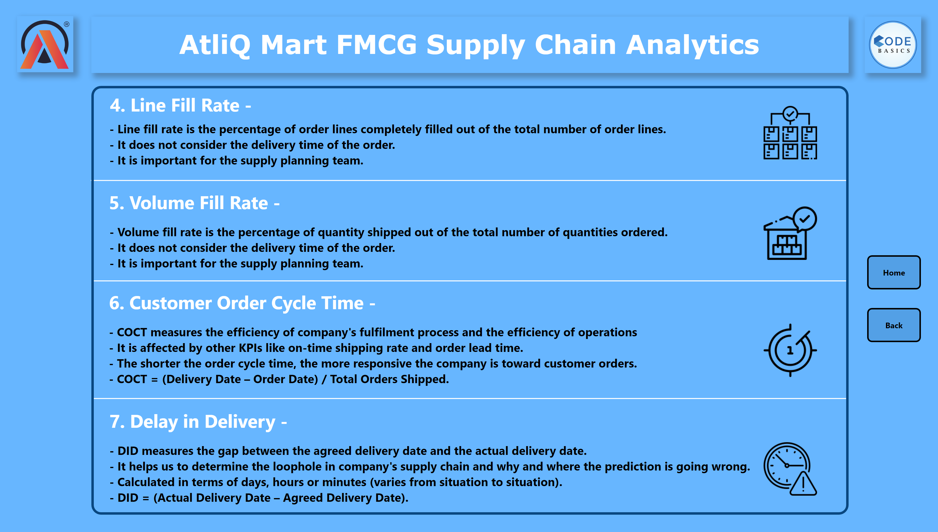
BG - KPIs - 2
Notes:
textbox
No alt text provided
shape
No alt text provided
image
No alt text provided
image
No alt text provided
textbox
No alt text provided
textbox
No alt text provided
textbox
No alt text provided
textbox
No alt text provided
textbox
No alt text provided
textbox
No alt text provided
textbox
No alt text provided
textbox
No alt text provided
shape
No alt text provided
shape
No alt text provided
shape
No alt text provided
image
No alt text provided
image
No alt text provided
image
No alt text provided
image
No alt text provided
shape
No alt text provided
actionButton
No alt text provided
actionButton
No alt text provided

